Slide 1
FALL DETECTION
Group Leader : M Kushagra, Id:- 2019H1400074H
Members : Ashutosh Khare, Id:- 2019H1400077H
Kunal Manna, Id:- 2019H1400076H
Rusha Mondal, Id:- 2019H1400072H
Shubham Tyagi, Id:- 2019H1400558H

Slide 2
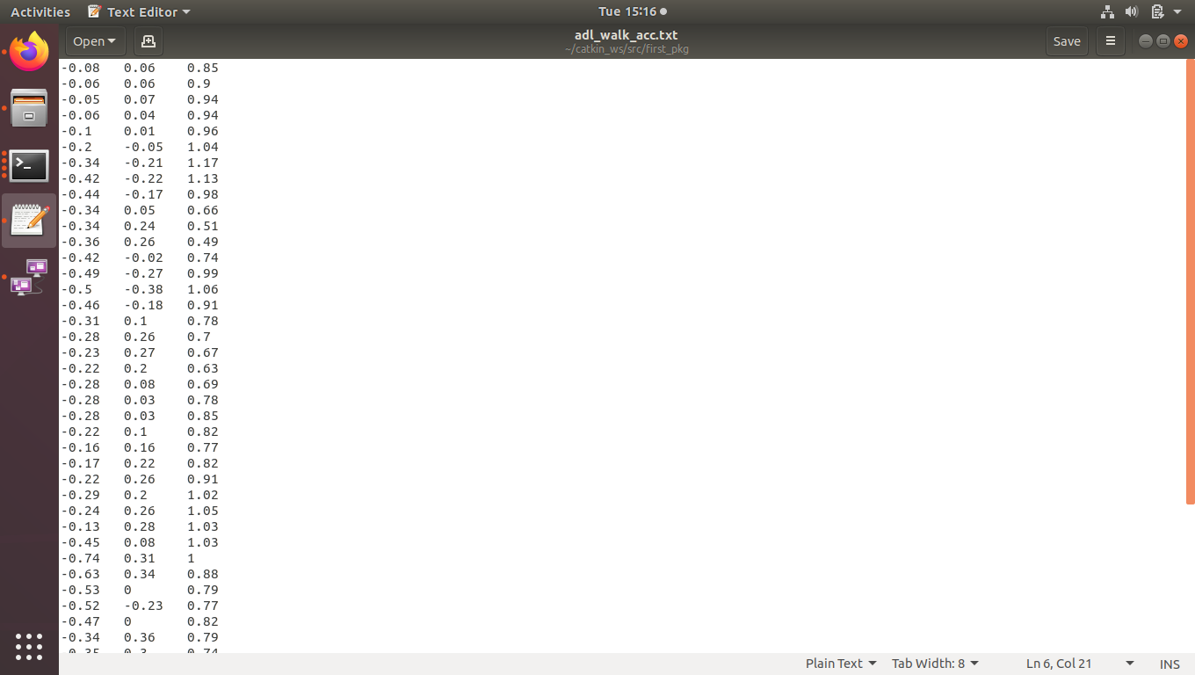
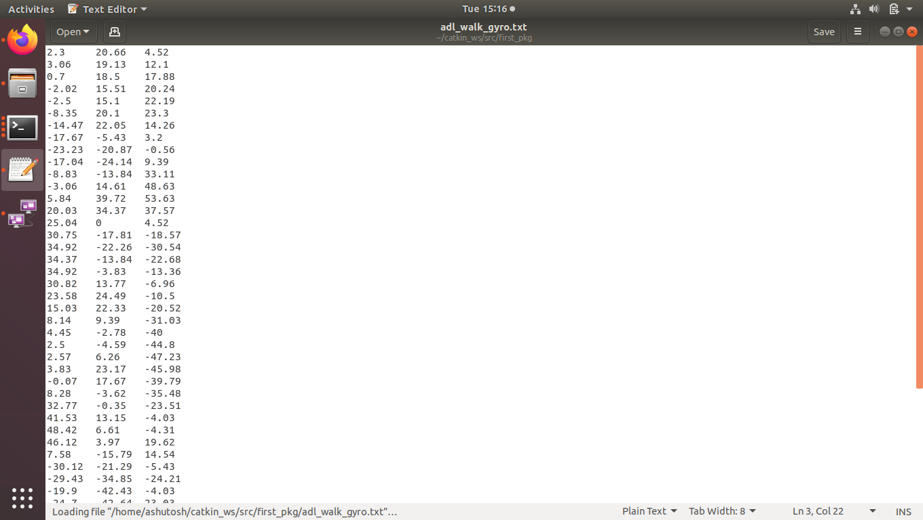
Input file(sensor axes)

Slide 3
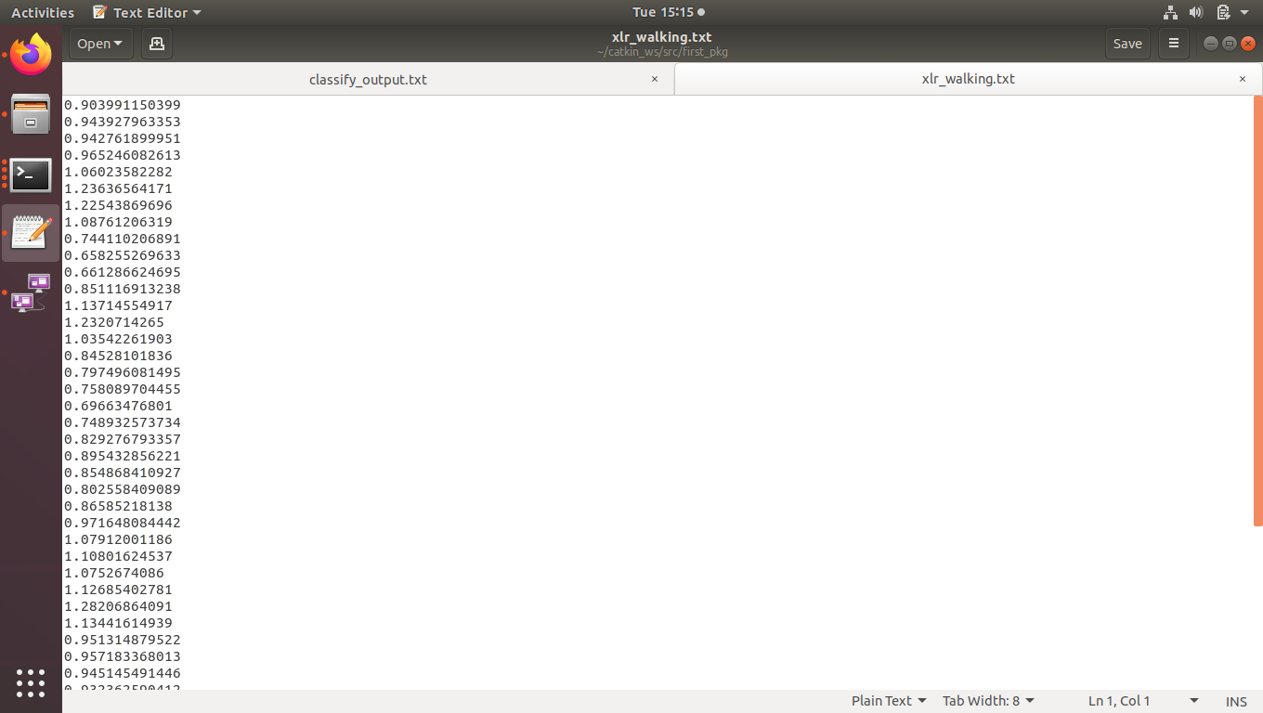
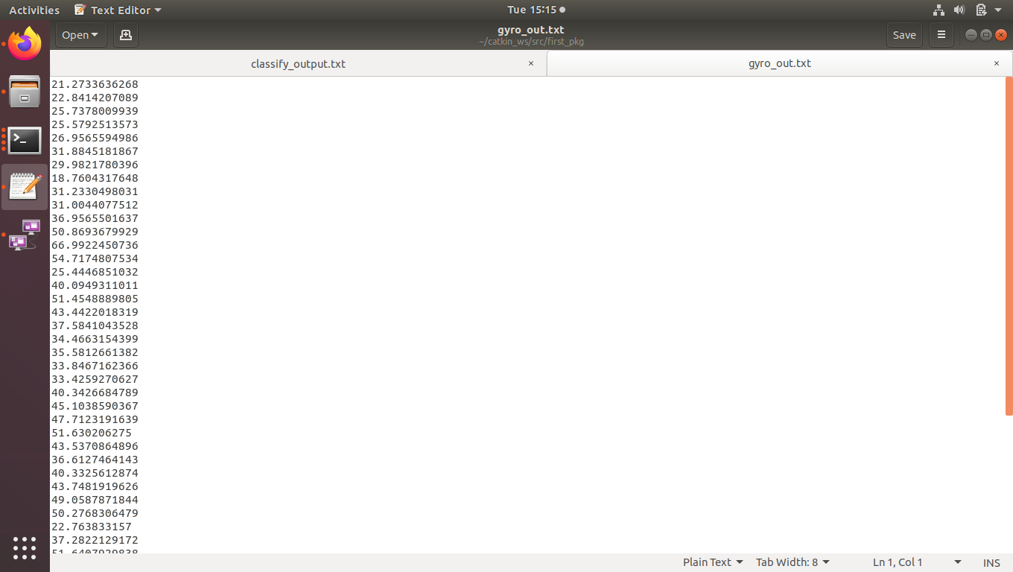
Processing Node
Accelerometer Input (mag) Gyroscope Input(mag)

Slide 4
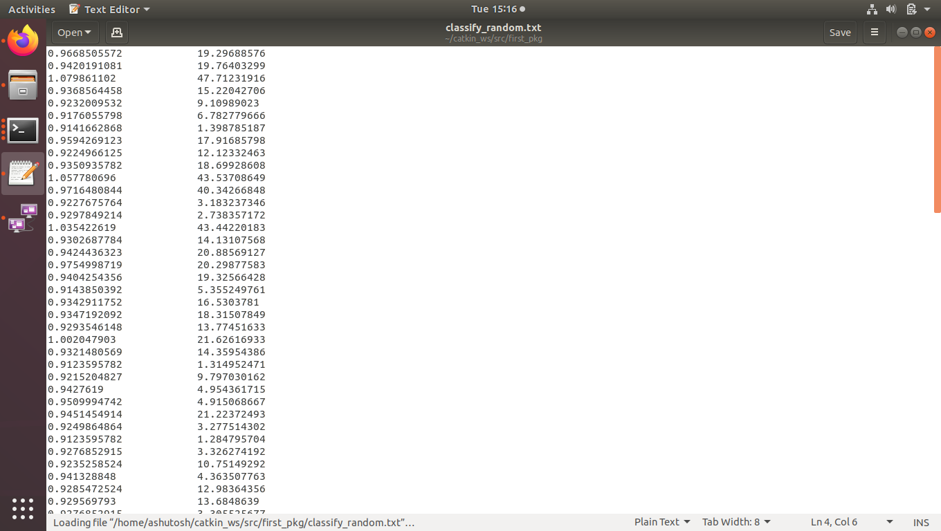
Accumulation of Data(Processing node)

Slide 5
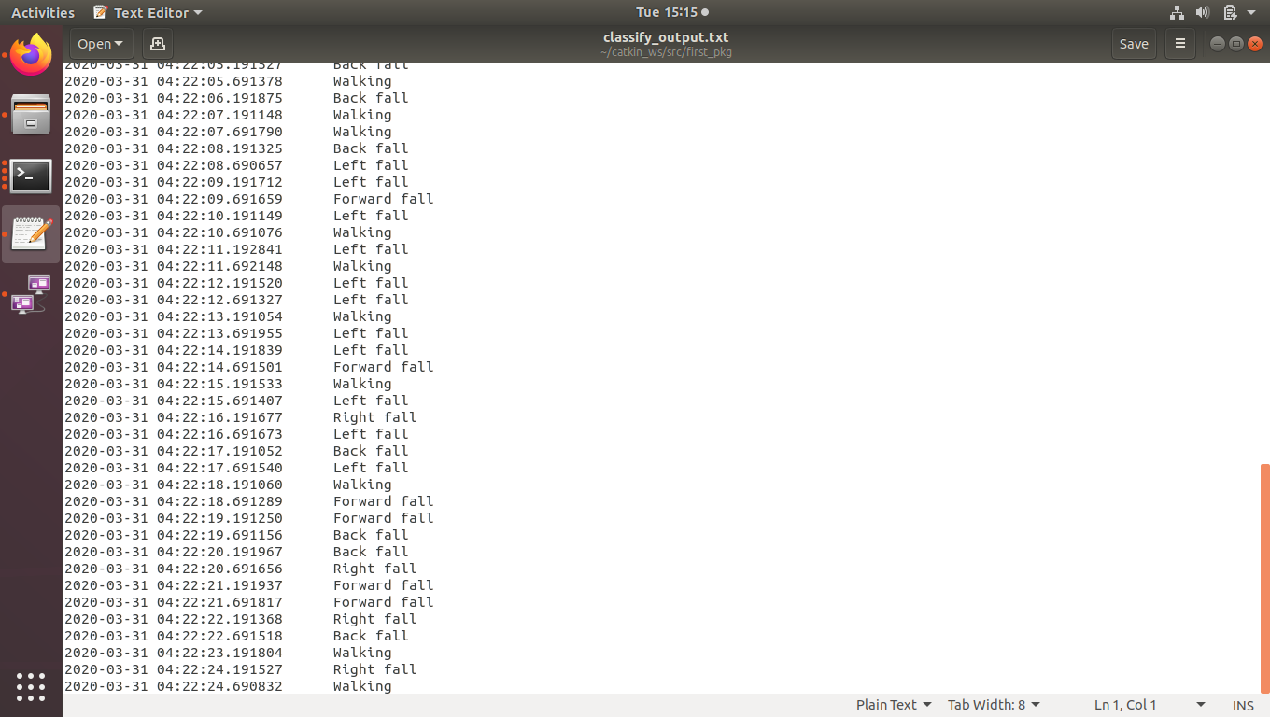
DECISION NODE OUTPUT

Slide 6
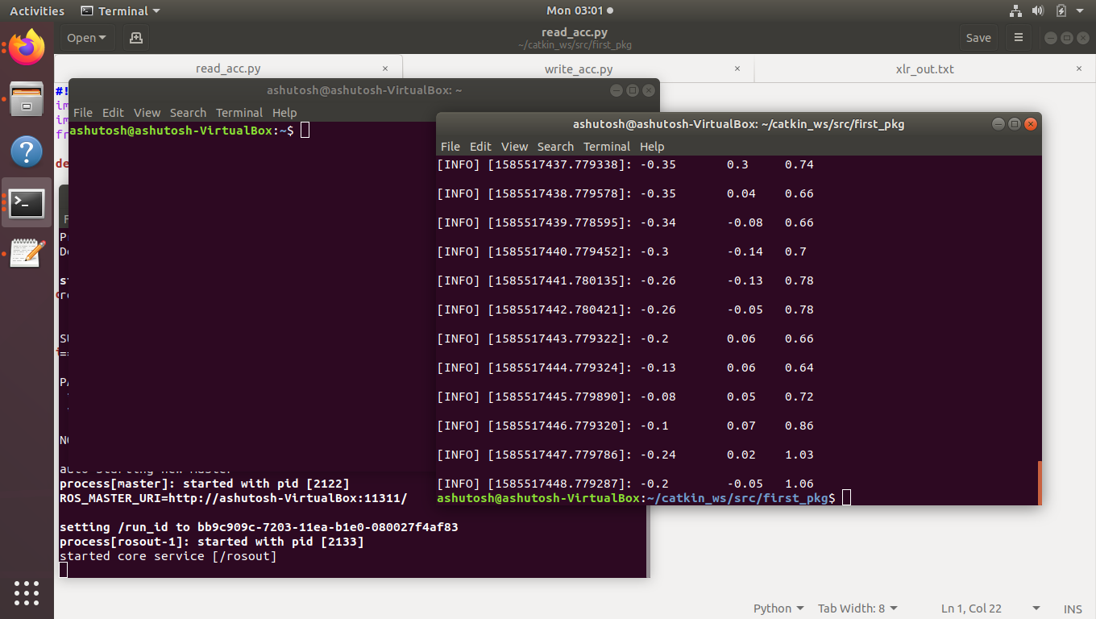
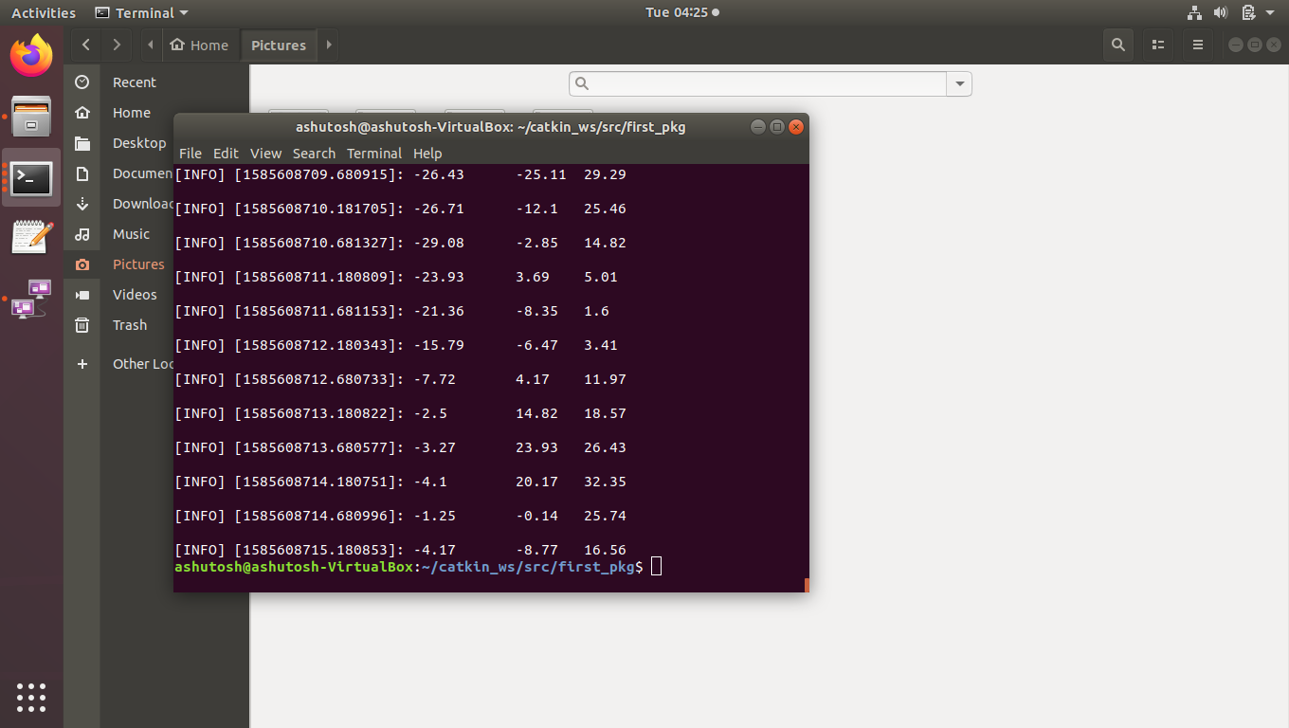


Slide 7
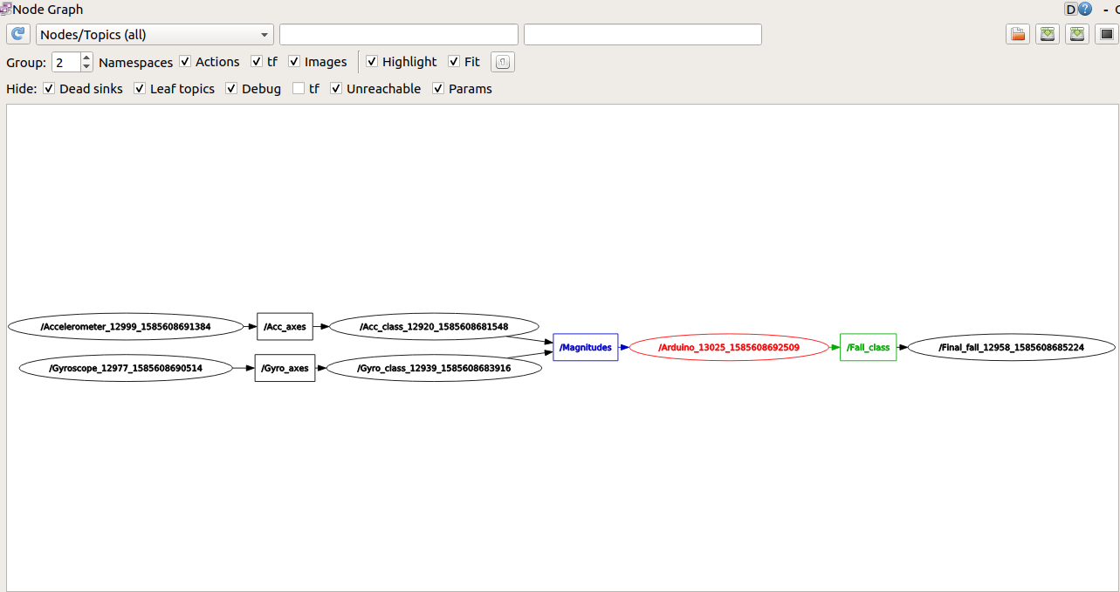

Slide 8
THANK YOU!

